Slide 1
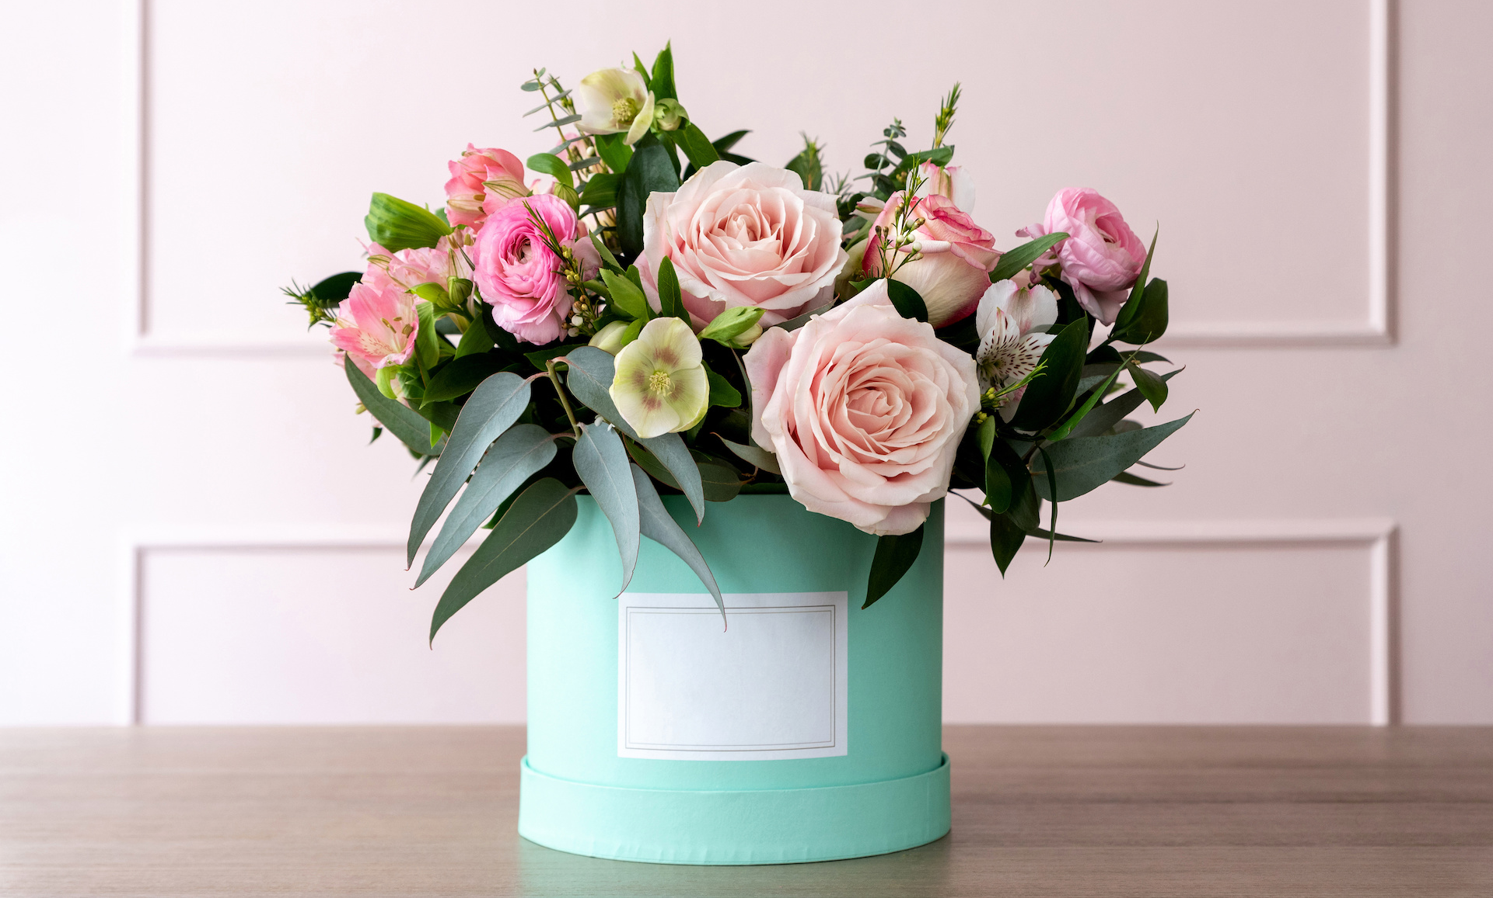
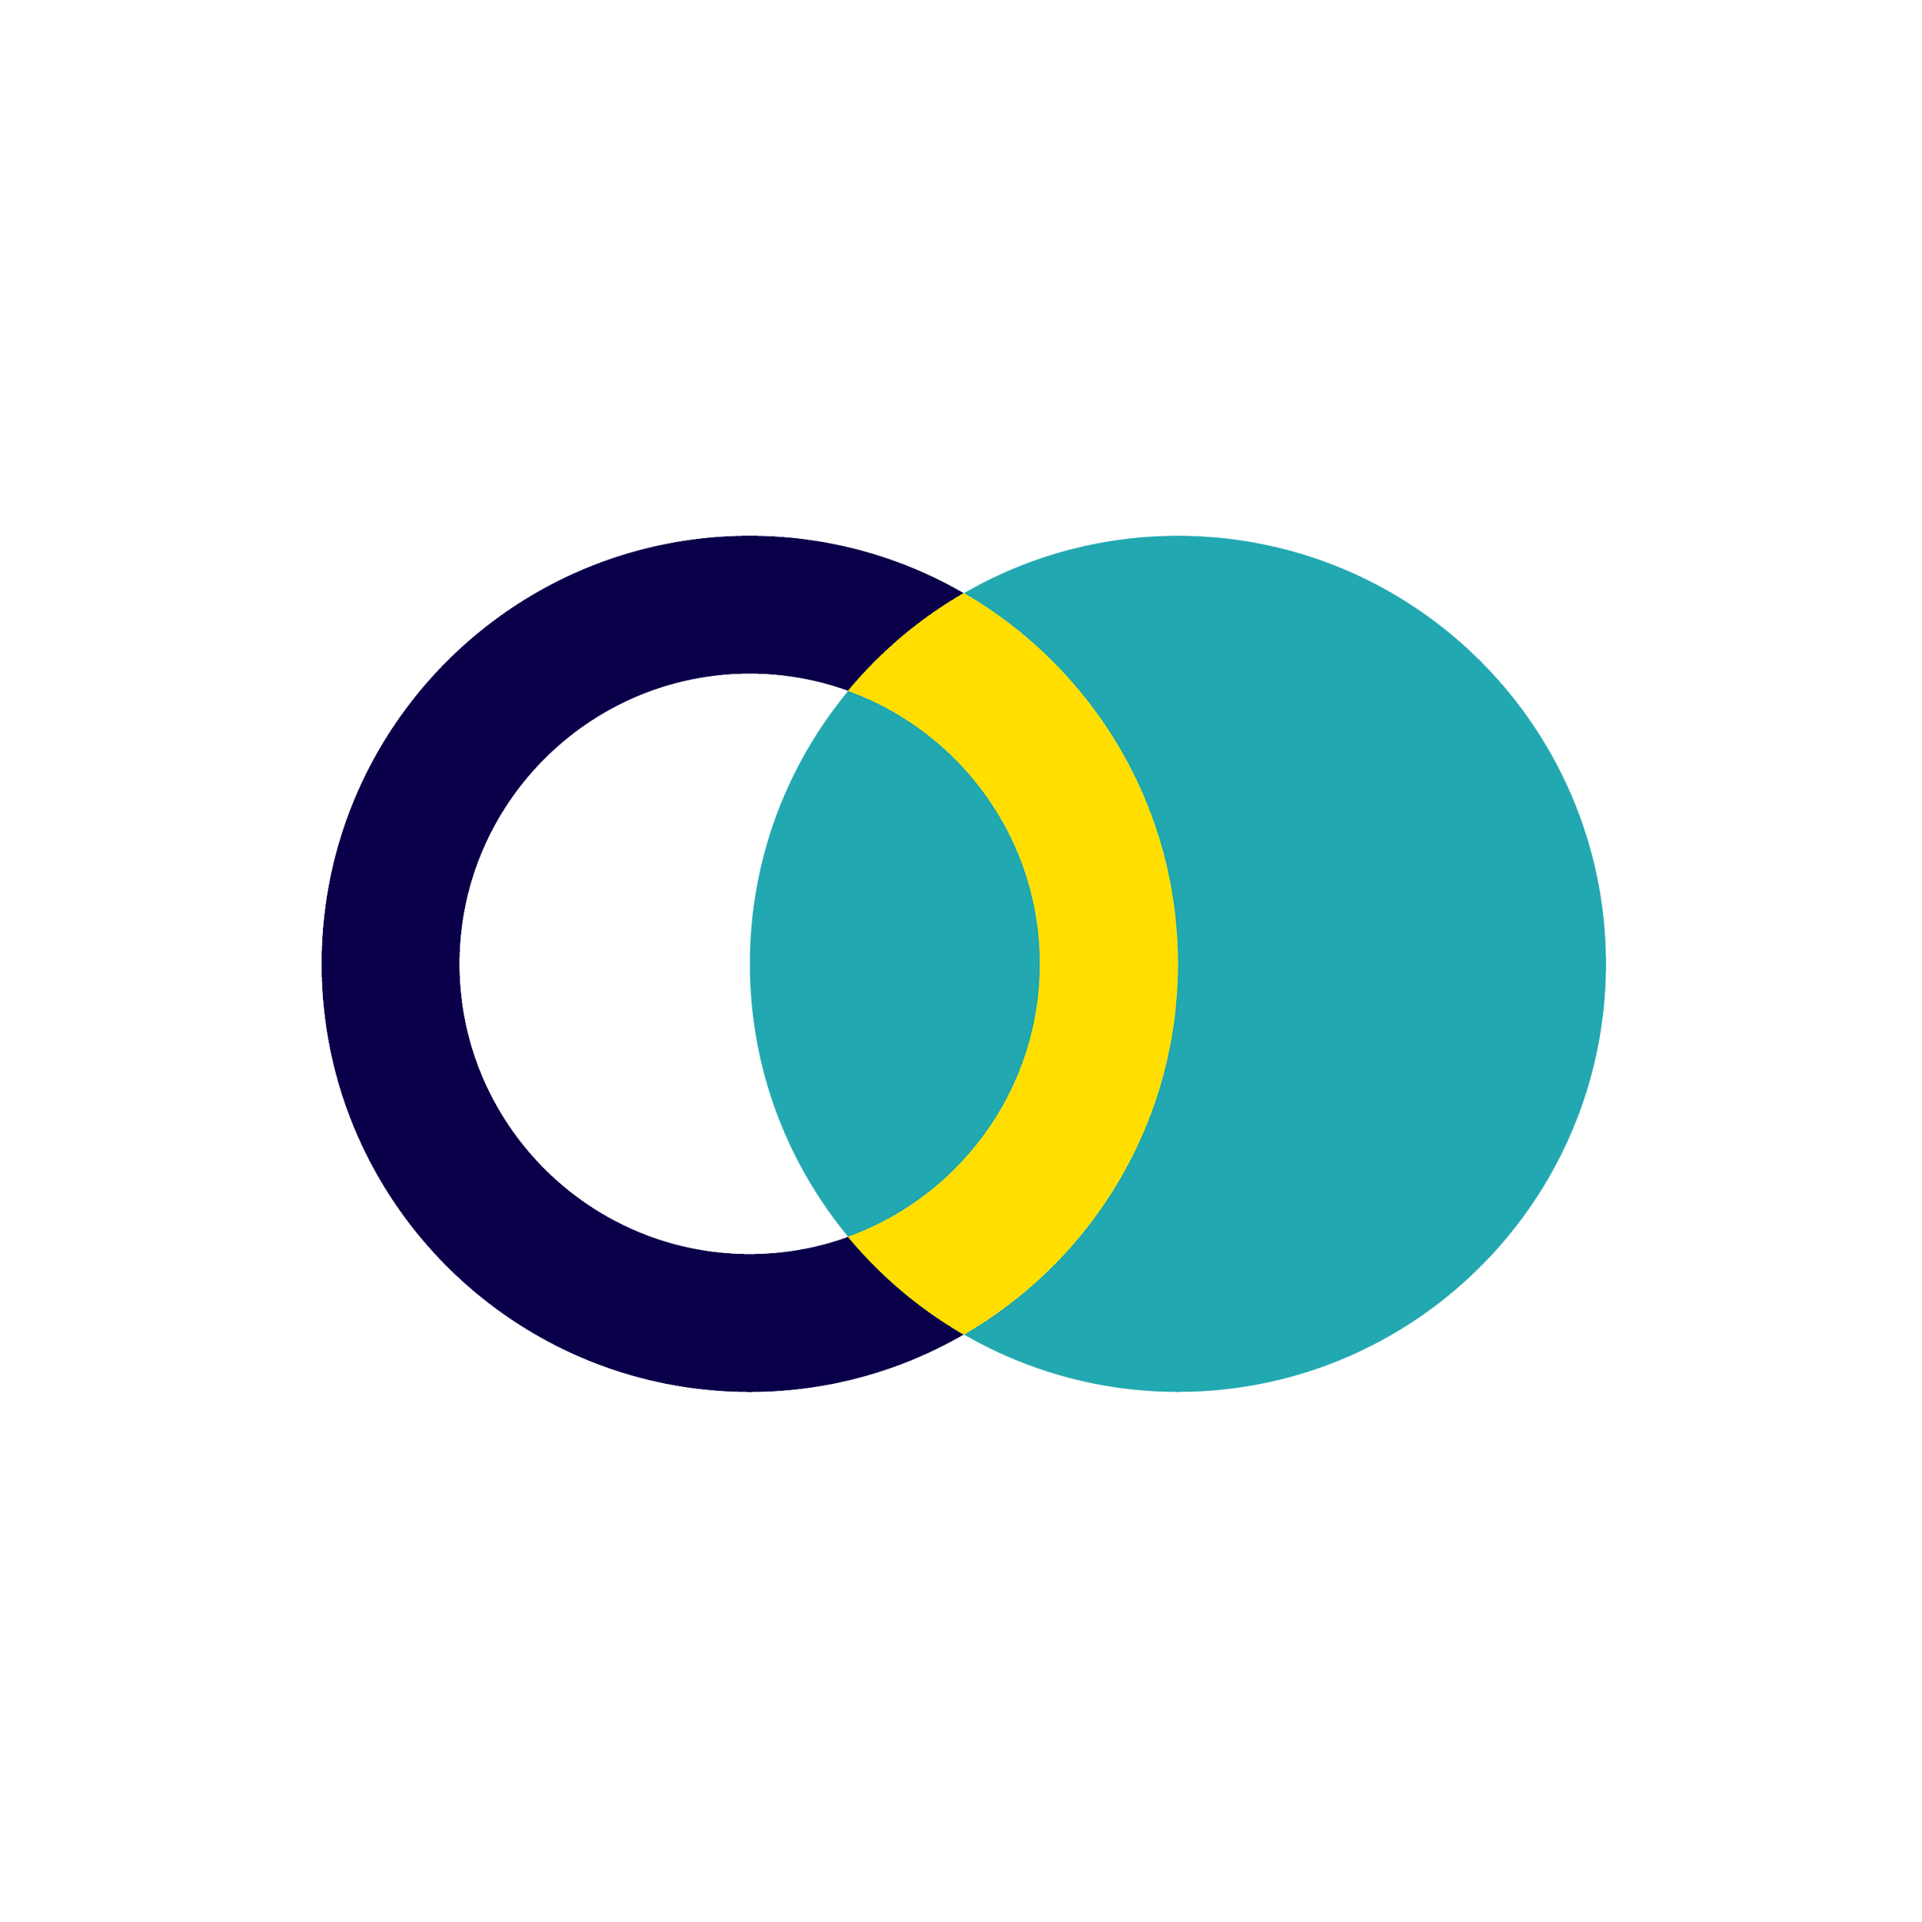
Calla & Ivy: Fall Promo Campaign Results

Slide 2
Goal
Increase online sales of the fall bouquet collection by 10% by the end of Q1.
Campaign Objective:
Generate high-volume traffic to the new e-commerce website to drive brand awareness and direct sales.
KPI:
Link Clicks
CTR (Click-Through Rate)

Slide 3
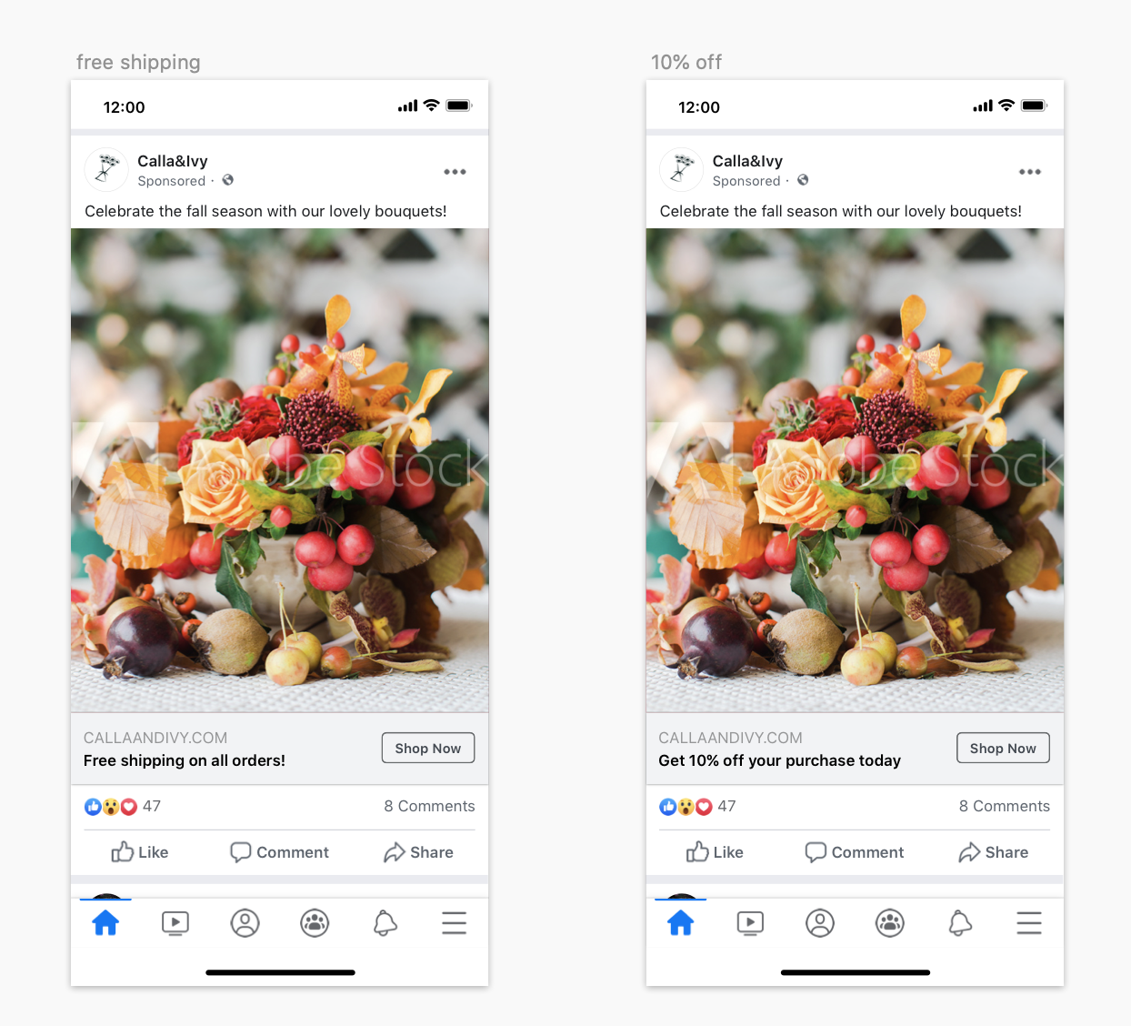
Creative
Assets
Ad A - Free Shipping Offer
Ad B - 10% Discount Offer

Slide 4
Campaign
Settings
Objective:
Traffic
Audience:
Women ages 24 - 55.
Interested in cut flowers.
Located in the Northern Holland region.
Placement:
Facebook, Instagram, and the Audience Network.
Duration:
Nov. 7 - Nov. 11.
Budget:
$2,824.50.

Slide 5
Results
Campaign Result
Total Link Clicks: 40,350
Average CTR: 1.2%
Average CPC: $0.07
Campaign Cost
Total Ad Spend: $2,824.50
ROAS: 11.43x
Revenue
$32,280.00
Total Investment
Advertising: $2,824.50
Cost of Goods (COG): $12,105.00
Total Investment: $14,929.50
ROI: 116%

Slide 6
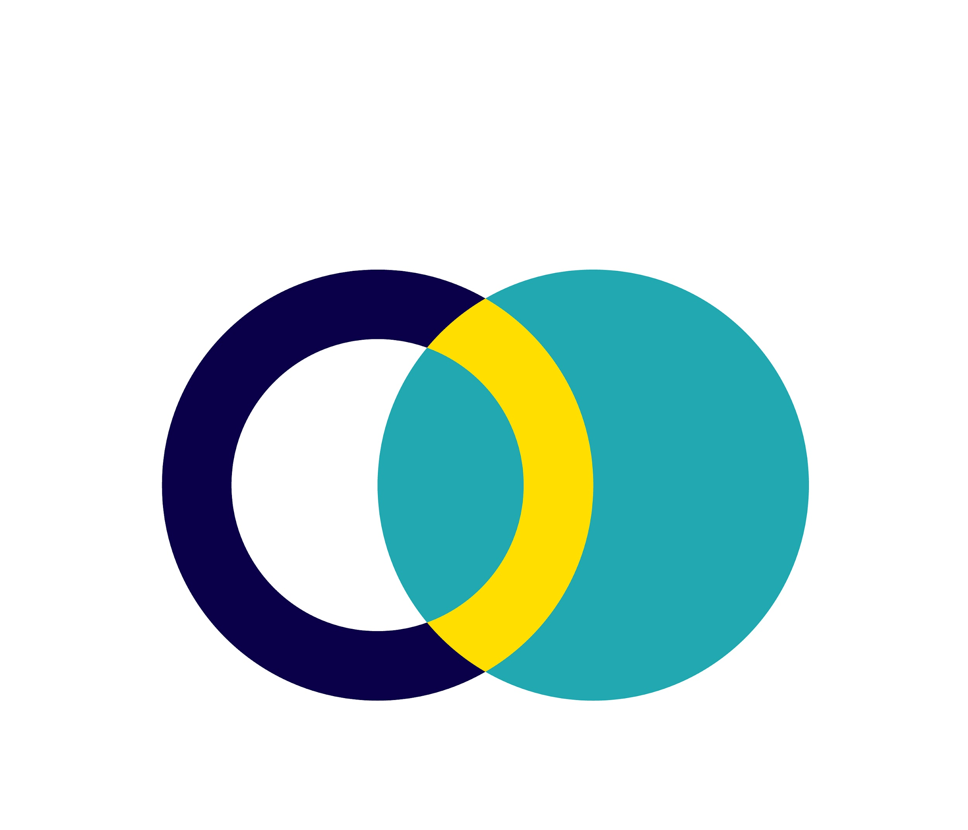
Results
Free Shipping (Winner):
38,780 Link clicks
1.4% CTR
$0.05 CPC
10% Off:
1,570 Link clicks
0.31% CTR
$0.48 CPC

Slide 7
Conclusion & Next Steps
Goal Met: Achieved 40,350 link clicks, delivering a high 11.43x ROAS and 116% ROI.
Key Insight: Free Shipping was the clear winner, driving 24x more traffic at a lower $0.05 CPC than the 10% discount.
Scale Winner: Increase daily budget for Free Shipping ads by 20% to maximize sales volume.
Test Video: Launch a short-form video ad to see if it can further improve the current 1.4% CTR.
Retargeting: Create a retargeting campaign for the 40,000+ users who clicked but did not purchase.

Slide 8
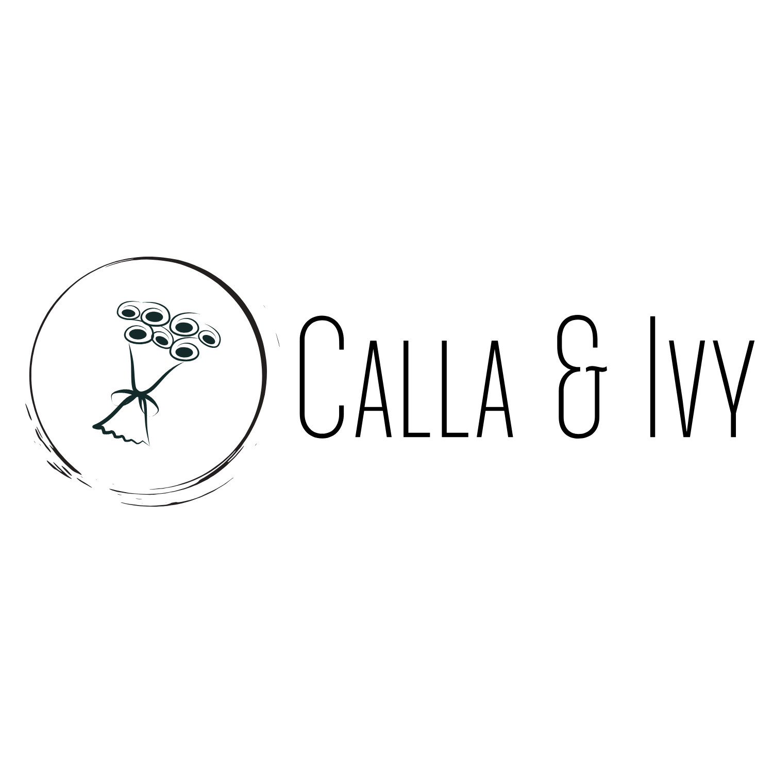


Thank
You!

